Slide 1
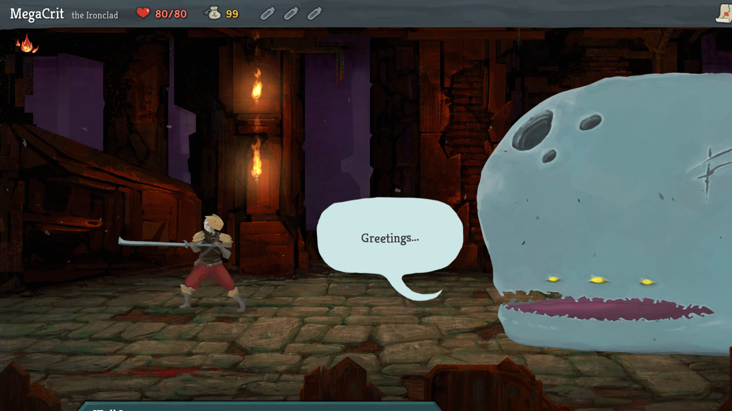
Slay the spire + GUI
Jonathan Sarasua

Slide 2
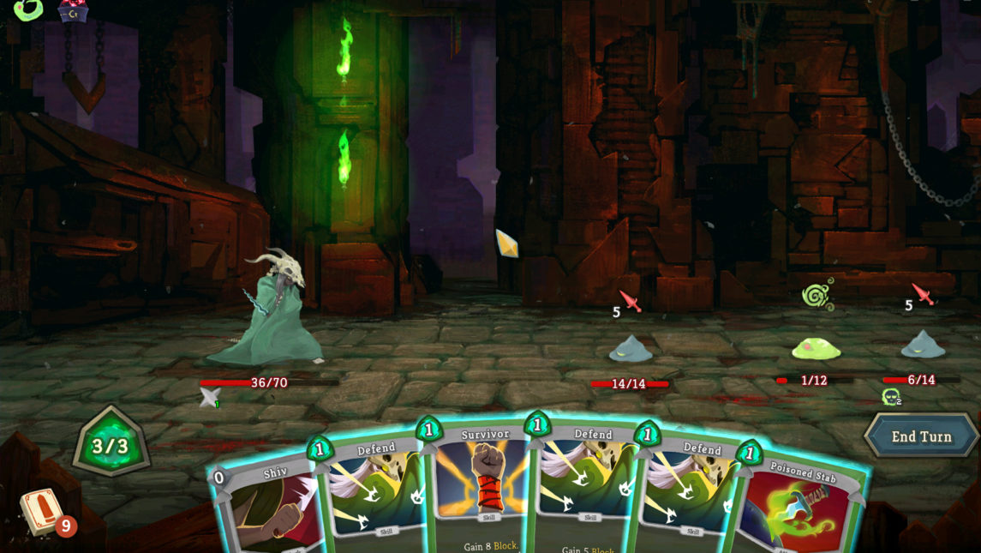
GUI system
Widgets
Widgets
Widgets
Widgets
Transform Hierarchy
States (Visible, Hidden, Pressed, Highlighted, Disabled, etc.)
Properties
Text, Text color, Background color, Image, and more
Cascading defaults
Transition states
XML based
Event System Integration

Slide 3
GUI system
Widgets
Widgets
Widgets
Widgets
Transform Hierarchy
States (Visible, Hidden, Pressed, Highlighted, Disabled, etc.)
Properties
Text, Text color, Background color, Image, and more
Cascading defaults
Transition states
Transitions
XML based
Event System Integration

Slide 4
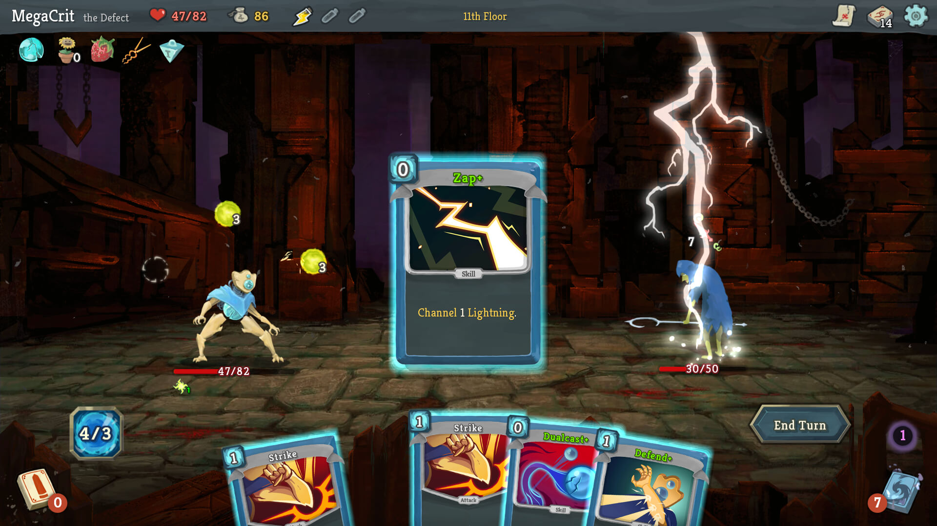
artifact
Mouse controls
Deckbuilding mechanics
Play cards, but have ways of gaining and removing cards
Slay The Spire-like rules and encounters

Slide 5
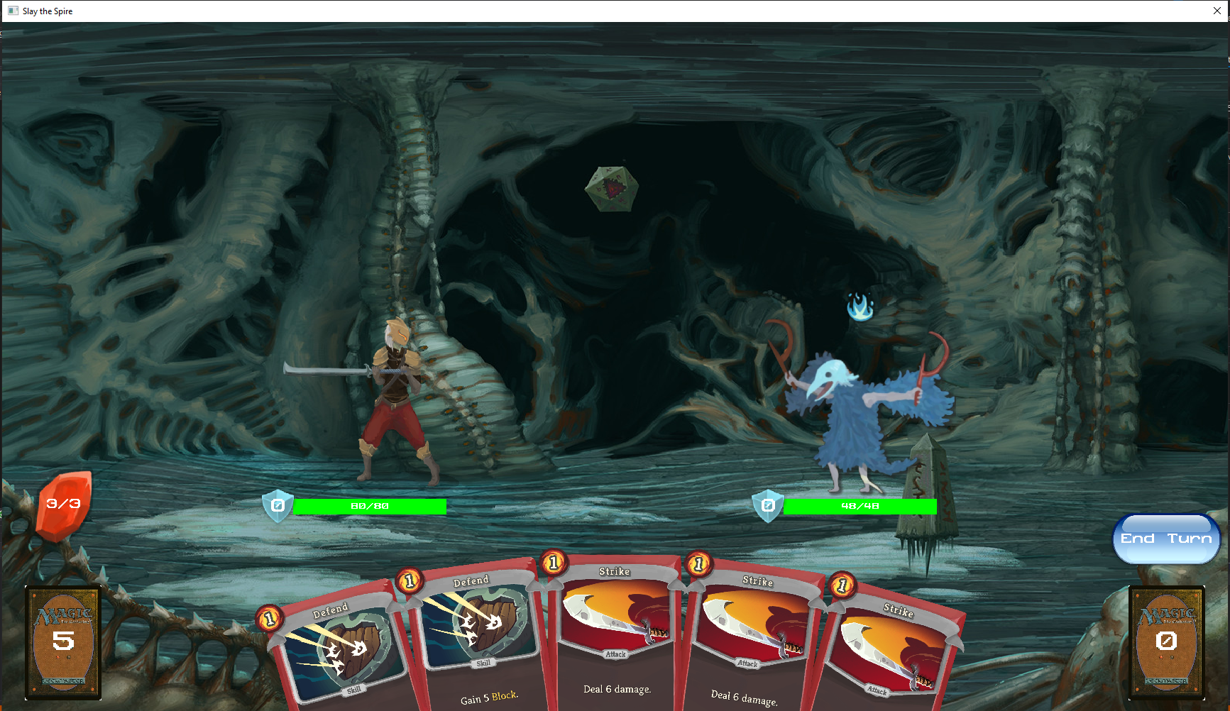
artifact
Mouse controls
Deckbuilding mechanics
Play cards, but have ways of gaining and removing cards
Slay The Spire-like rules and encounters
Transitions
Lots of cards
Smooth playing

Slide 6
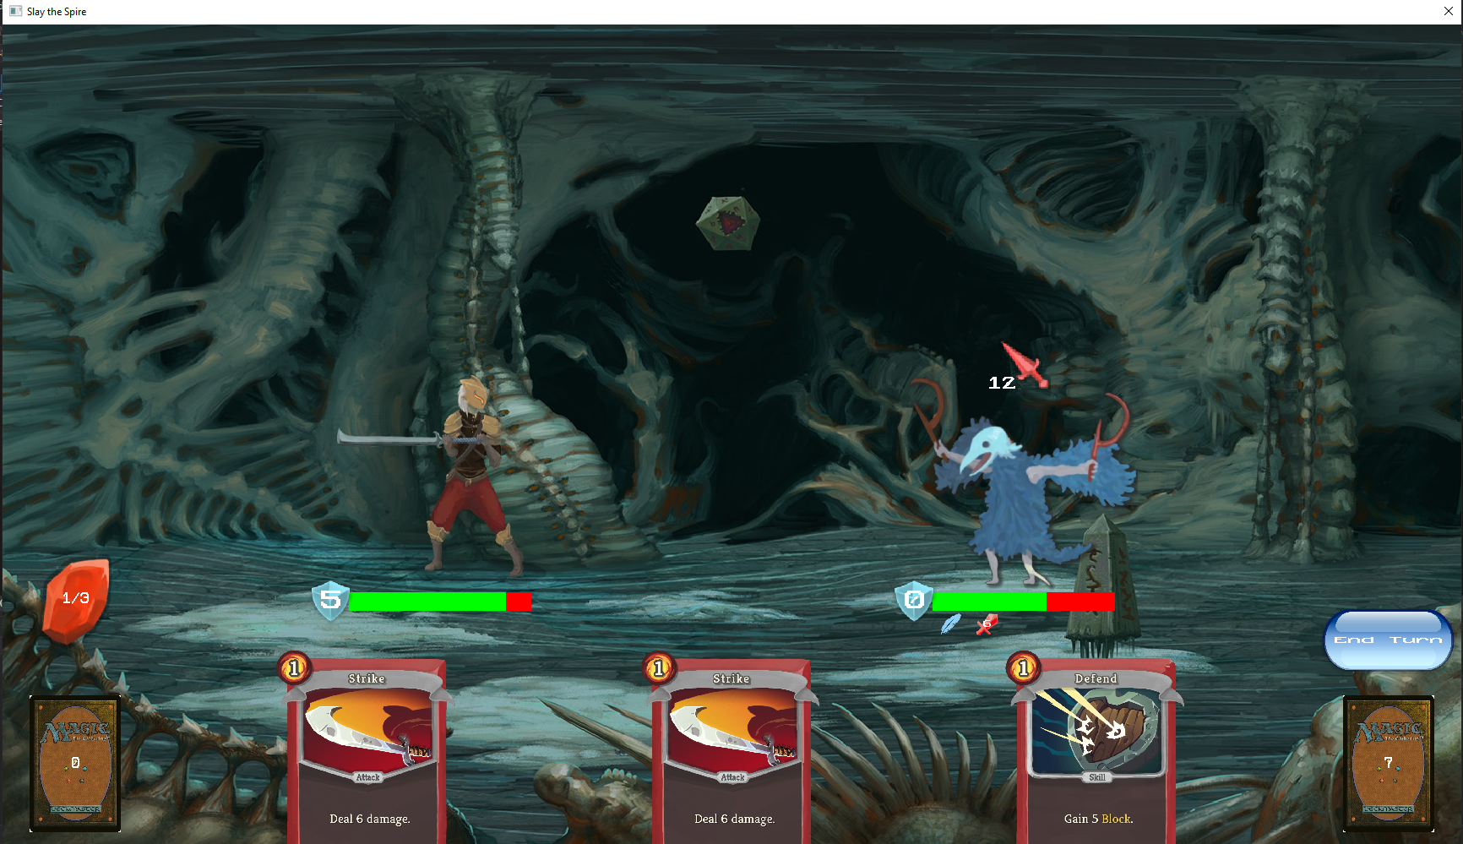
Intent (MoveTypeDefinition)
Player
Energy
Block
Health
Enemy (EnemyDefinition)
Card (CardDefinition)
Statuses (StatusDefinition)

Slide 7
Intent (Widget)
Player (Widget)
Energy (Widget)
Health (WidgetSlider)
Enemy (Widget)
Card (Widget)
Statuses (WidgetGrid)

Slide 8
Widget Construction
Set Transform
Scale = Dimensions
Position = Center of Widget relative to parent Widget
SetCanSelect( True )
SetEventToFire( “EventName” )
SetText( “End Turn” )
SetTextSize( 0.1f )
SetTexture( baseTex, hoverTex, selectTex )
ReleaseDelegate
Subscribe PlayCard

Slide 9
Event System Integration
When a card is played
Call StartPlayCard()
Do card effects
Start animation to discard pile
Subscribe EndPlayCard to EndAnimation
Call EndPlayCard()
Do card cleanup like MatchUIToGameState()

Slide 10
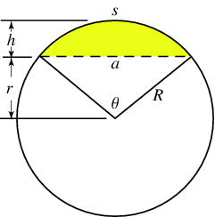
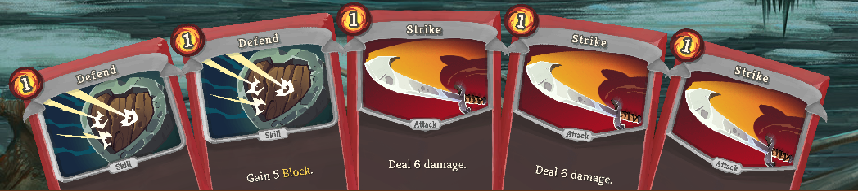
Hand Positions
GetGoalHandTransforms()
a = Hand Width
h = Hand Height / 2
a = 2 √( h * (2*R – h ) )
R= ( a²/ (4*h) + h ) / 2
h
a

Slide 11
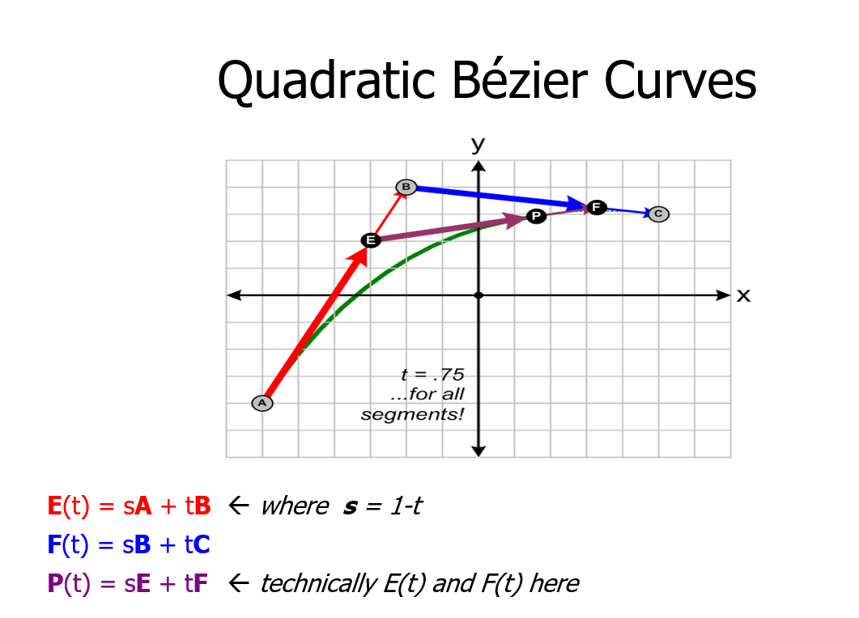
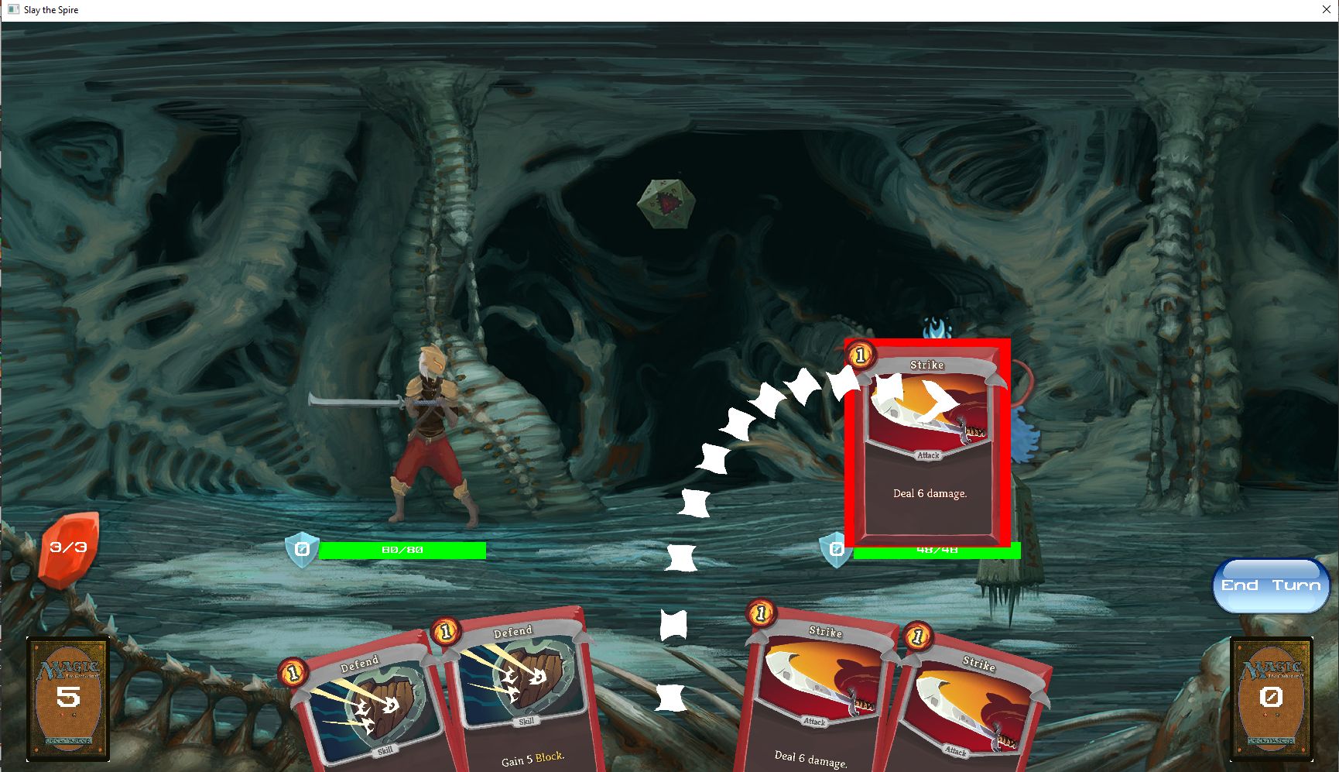
Bezier Curve
A = Card Initial Position
B = A + PushValue*Up
C = Card Current Position

Slide 12
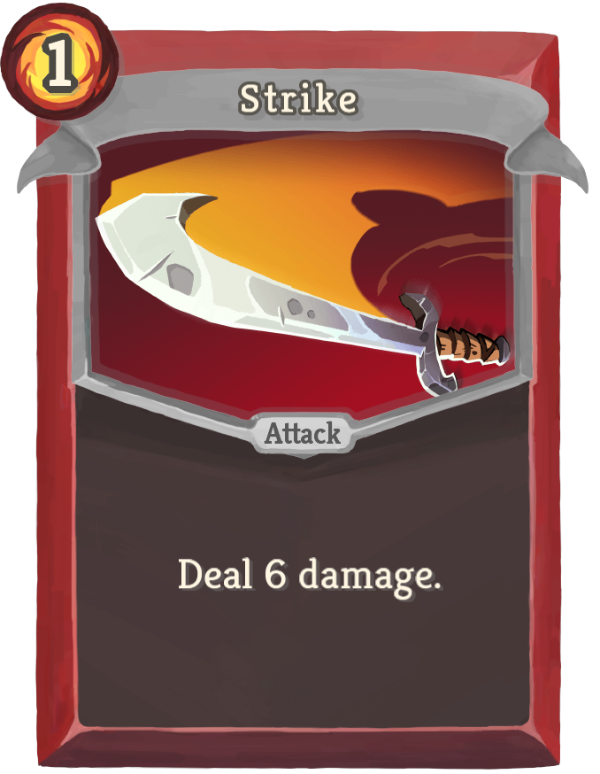
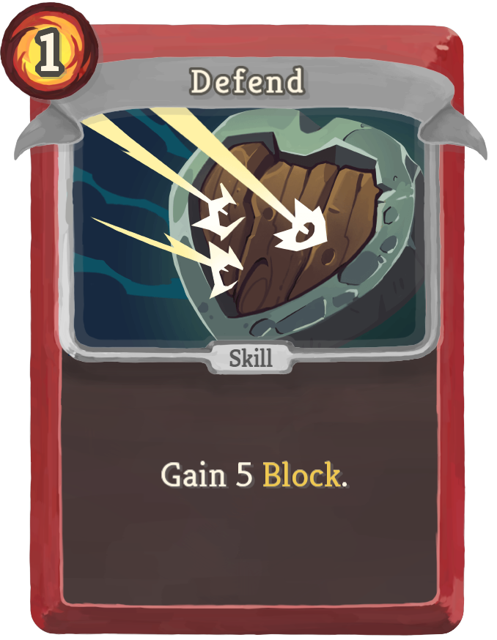
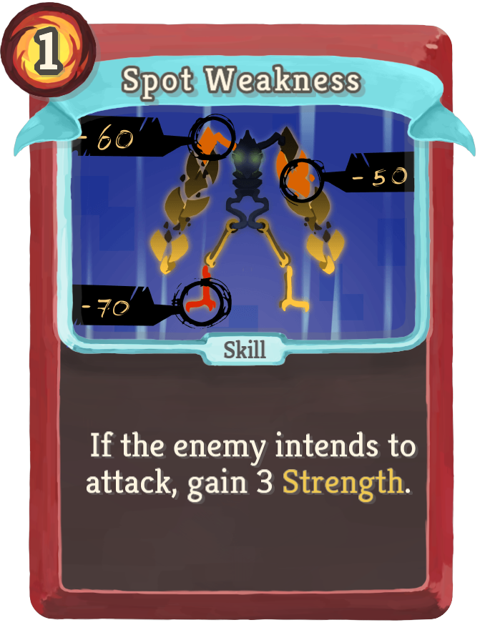
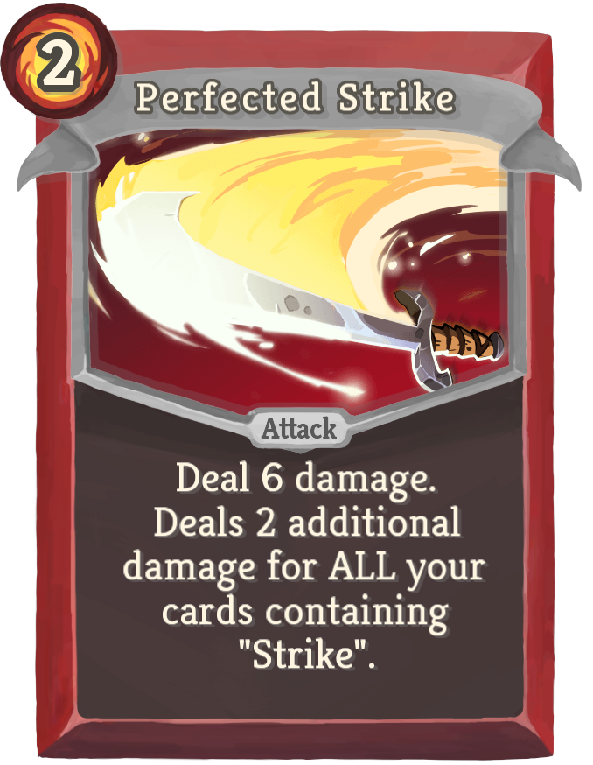
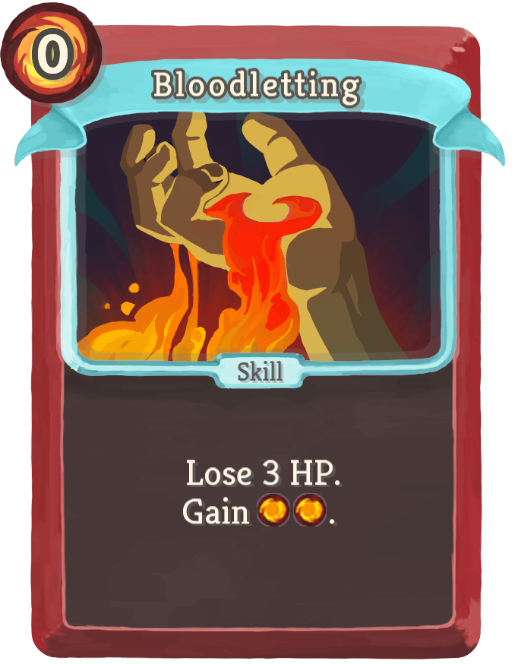
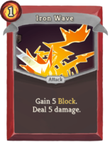
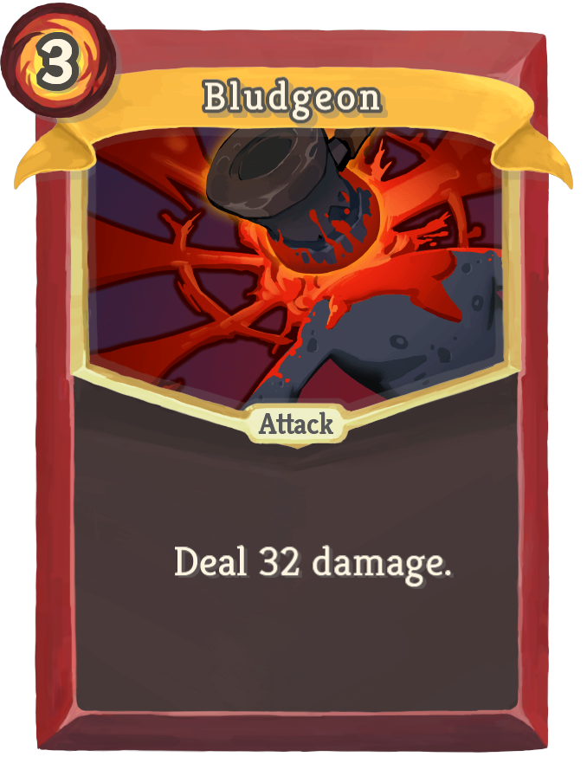
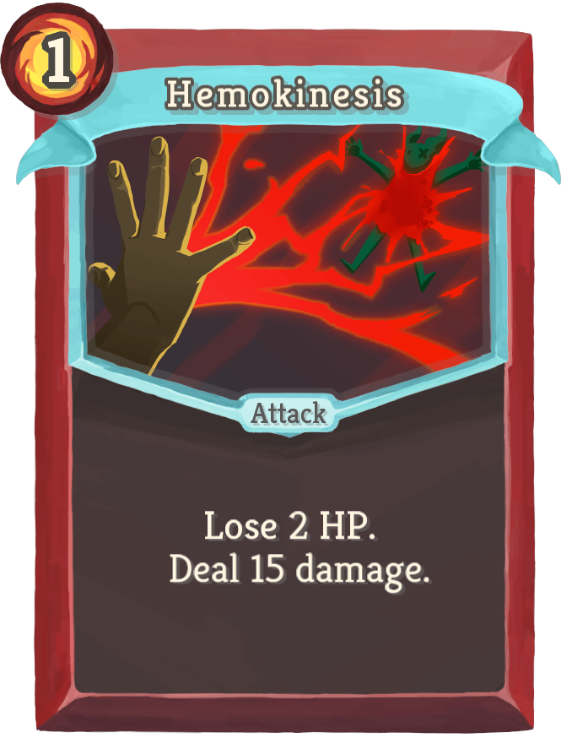
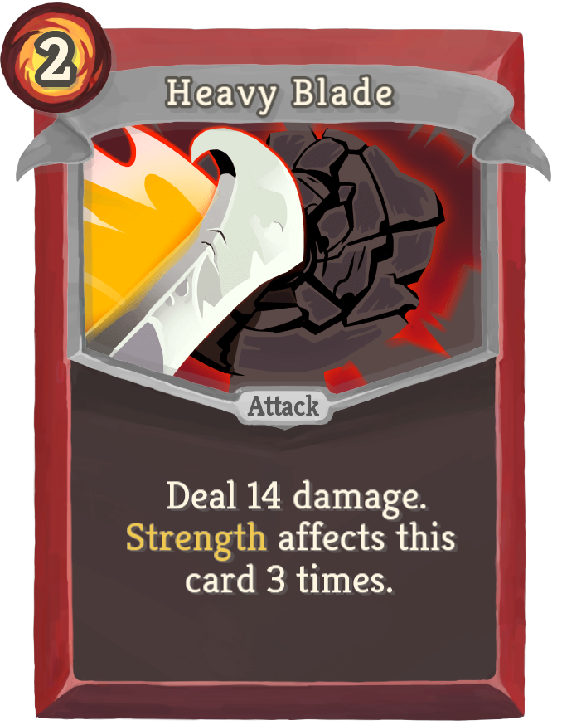
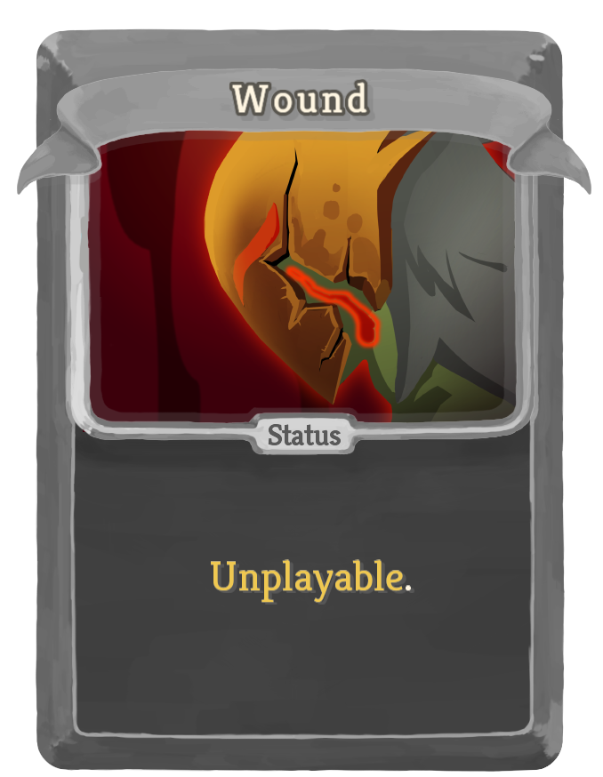
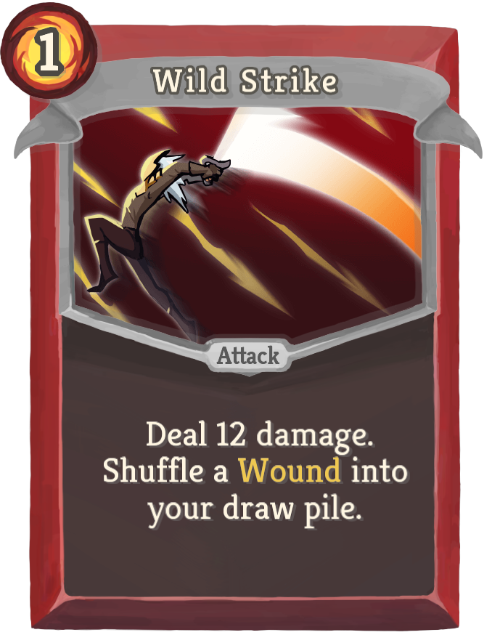
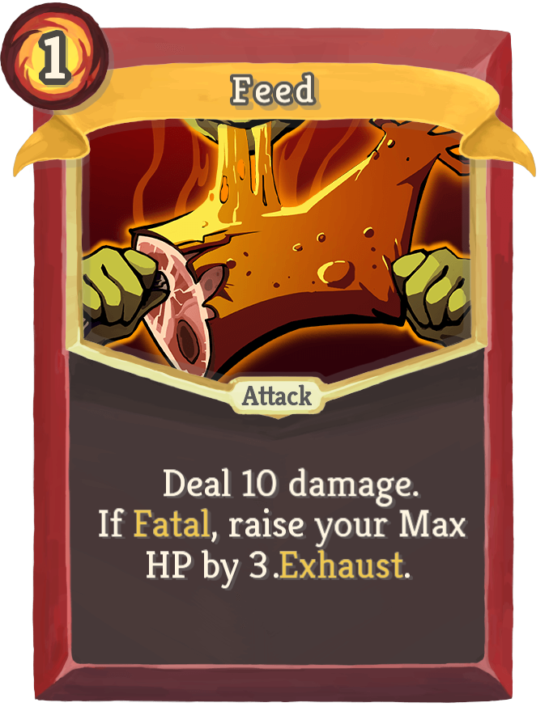
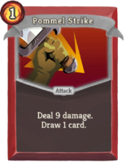
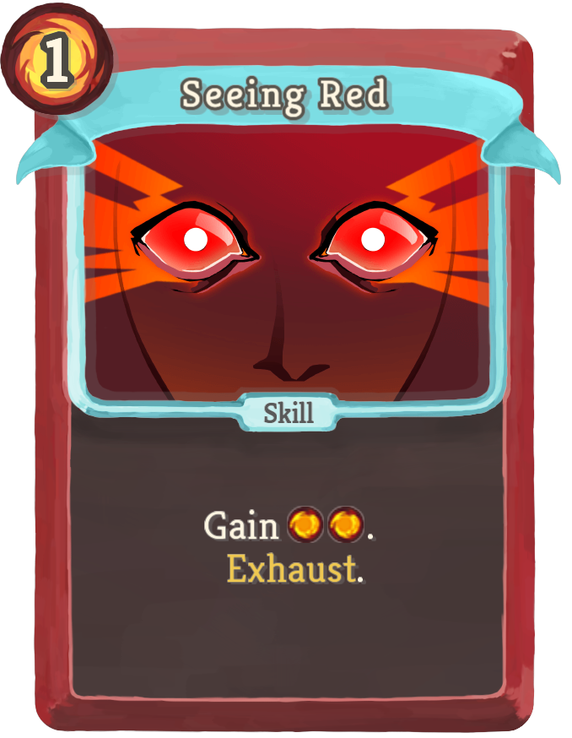
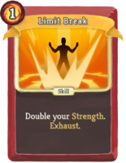
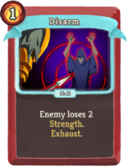
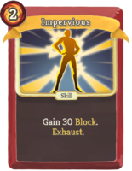
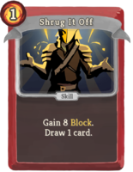
More Cards
Pivoted to adding more cards instead of more features

Slide 13
Card effects
Deal Damage
Gain Block

Slide 14
Card effects
Gain Strength
Enemy Lose Strength
Exhaust

Slide 15
Card effects
Lose Health
Gain Energy

Slide 16
Card effects
Draw card
Difficult due to animations
Treating hand as unordered set
Must update widget order, so overlap is correct

Slide 17
Card effects
Add Wound to deck
Max HP increase
Strength multiplier
Increase damage based on strikes

Slide 18
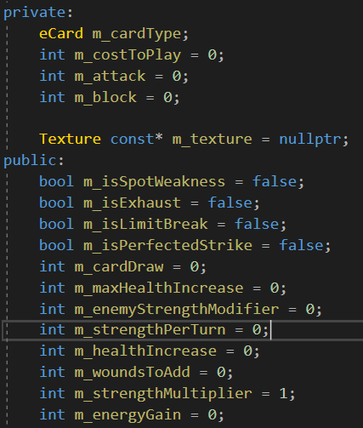
Card Effects

Slide 19
Lessons Learned
Game code consumes all
Transitions make everything better
…and more complex
Compartmentalize card effects
Organize event/state pipeline

Slide 20
Time estimate review
Original plan good
Estimates good
Pivot was good

Slide 21
What would I do differently?
Code with multiple enemies in a fight in mind
Use a vector for hand instead of an unordered set

